Slide 1

B.Tech Final Project Presentation on
AI-Based Multi-View Muscle Hypertrophy Tracking and Fitness Analytics System Using Computer Vision
Department of Computer Science and Engineering
Registration no. | Student Name
22ETCS002104 | Sives Sundar Manna
22ETCS002109 | Suman Debnath
22ETCS002081 | Rahul Pal
Mentor : Ms Sheethal Raj T G
Group No. : PB 81

Slide 2
Outline
Problem Statement & Motivation
Objectives
Existing System
Proposed System
System Architecture
Implementation and Testing
Result Analysis and Discussions
Live Demonstration
Conclusion
Future Scope
References

Slide 3
Problem Statement and Motivation
Problem Statement :
Traditional fitness progress tracking relies heavily on:
  manual tape measurements
  subjective mirror comparisons
  inconsistent gym progress observations
Current consumer tools:
  require expensive 3D scanners
  use wearable sensors
  fail to provide affordable muscle-focused tracking
Motivation:
Need for:
  low-cost automated body measurement
  objective hypertrophy monitoring
  longitudinal progress analytics
  AI-assisted personal fitness tracking

Slide 4
Objectives
Primary objectives:
  Develop automated body measurement system using computer vision
  Capture body dimensions using multi-view pose estimation
  Construct pseudo-3D anthropometric metrics
  Track longitudinal fitness progress over time
  Provide intuitive dashboard visualization

Slide 5
Existing System
Research Gap:
  No accessible low-cost multi-view AI hypertrophy tracking system focused on muscle growth monitoring.
Existing Approach | Limitation
Manual tape measurements | human error, inconsistent
Mirror/photo comparison | subjective
Smart wearables | indirect estimation
Commercial 3D body scanners | expensive
Generic fitness apps | no actual body measurement

Slide 6
Existing System
Existing Methods:
  Static 2D body measurement estimation
  Generic pose-based anthropometry
  Body composition/fat estimation systems
Limitations:
  Mostly static measurements
  No longitudinal muscle growth tracking
  Limited depth estimation in single-view systems
Research Gap:
  No low-cost automated multi-view hypertrophy tracking system
  Lack of pseudo-3D growth modeling and trend analysis

Slide 7
Existing System
Ref | Title & Year | Methodology | Dataset | Limitations | Observations
[1] | 2D Image-Based Digital Anthropometry Using Deep Learning (2024) | Deep learning-based landmark extraction from RGB images for body measurement estimation | RGB images of human subjects (single-session) | Focused on static body measurement; no longitudinal tracking | Demonstrates feasibility of 2D landmark-based anthropometry but lacks time-series modeling
[2] | Agreement of Anthropometric and Body Composition Measures Predicted from 2D Smartphone Images (2022) | Smartphone image-based body composition estimation compared with reference methods | Smartphone-captured 2D images with manual/DXA reference data | Focused on body fat & composition, not hypertrophy | Validates potential of 2D images for body metrics but not muscle growth tracking
[3] | Development and Validation of a Smartphone Application for Measuring Waist-to-Hip Ratio (2023) | Computer vision-based circumference estimation using smartphone images | Controlled smartphone image dataset | Limited to waist/hip metrics; no multi-region modeling | Shows smartphone CV can estimate circumferences reliably
[4] | Advances in Estimation of Body Fat Percentage Using AI 2D Photo Method (2025) | Deep learning regression model for fat % prediction from 2D photos | Large-scale 2D image dataset | Focused on fat estimation; not muscle-specific | Reinforces 2D viability but domain differs from hypertrophy
[5] | Prediction of Body Composition Using 2D Image-Derived 3D Meshes (2024) | 2D images converted into approximate 3D body meshes for composition analysis | Multi-view RGB images with mesh reconstruction | Computationally heavy; not mobile-first | Highlights benefit of pseudo-3D modeling
Existing system can be shown in table form also:

Slide 8
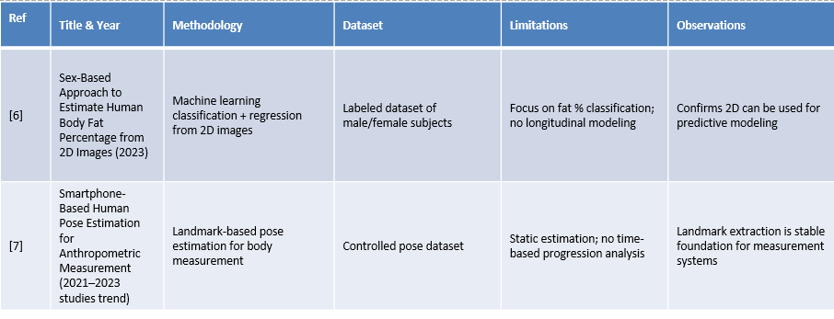
Existing System

Slide 9
Proposed System
NeoFit provides:
  webcam-based measurement capture
  front + left + right view pose acquisition
  landmark extraction using MediaPipe
  silhouette-based torso width/depth estimation
  pseudo-3D circumference reconstruction
  session storage
  dashboard analytics
Future intelligence:
  goal-aware prediction
  adaptive diet planning

Slide 10
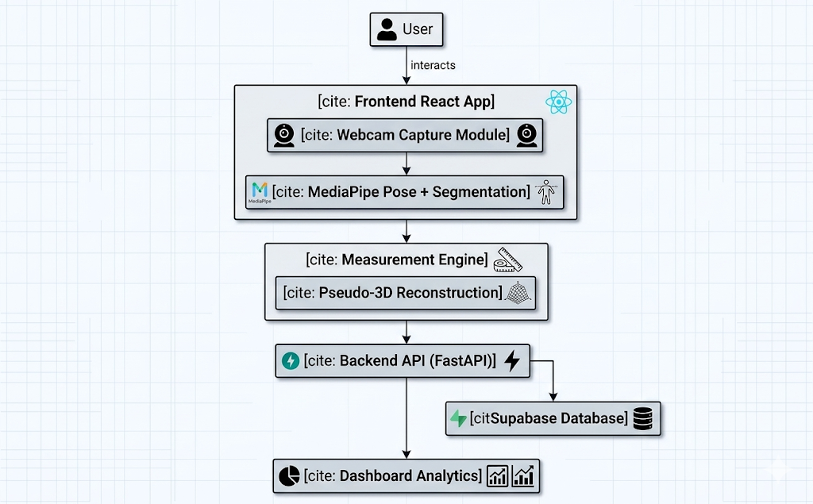
System Architecture/Block Diagram

Slide 11
Methodology
Pipeline:
  Step 1
    Profile setup
    (height, weight, goal, activity level)
  Step 2
    3-view capture
    front
    left
    right
  Step 3
    Landmark detection
    33 pose keypoints
  Step 4
    Silhouette extraction
    torso + limb metrics
  Step 5
    Geometric reconstruction
    ellipse approximation
  Step 6
    Storage + analytics

Slide 12
Technology Stack
Frontend:
  React
  TypeScript
  TailwindCSS
  TanStack Query
Backend:
  FastAPI
  Python
  Computer Vision:
  OpenCV
  MediaPipe
  NumPy
Database:
  Supabase PostgreSQL
Visualization:
  Recharts

Slide 13
Testing and Validation
Validation approach:
  repeated scans
  manual tape comparison
  consistency analysis
  unit testing
  integration testing
Metrics validated:
  arm girth
  thigh girth
  chest
  waist
  hip
  symmetry metrics

Slide 14

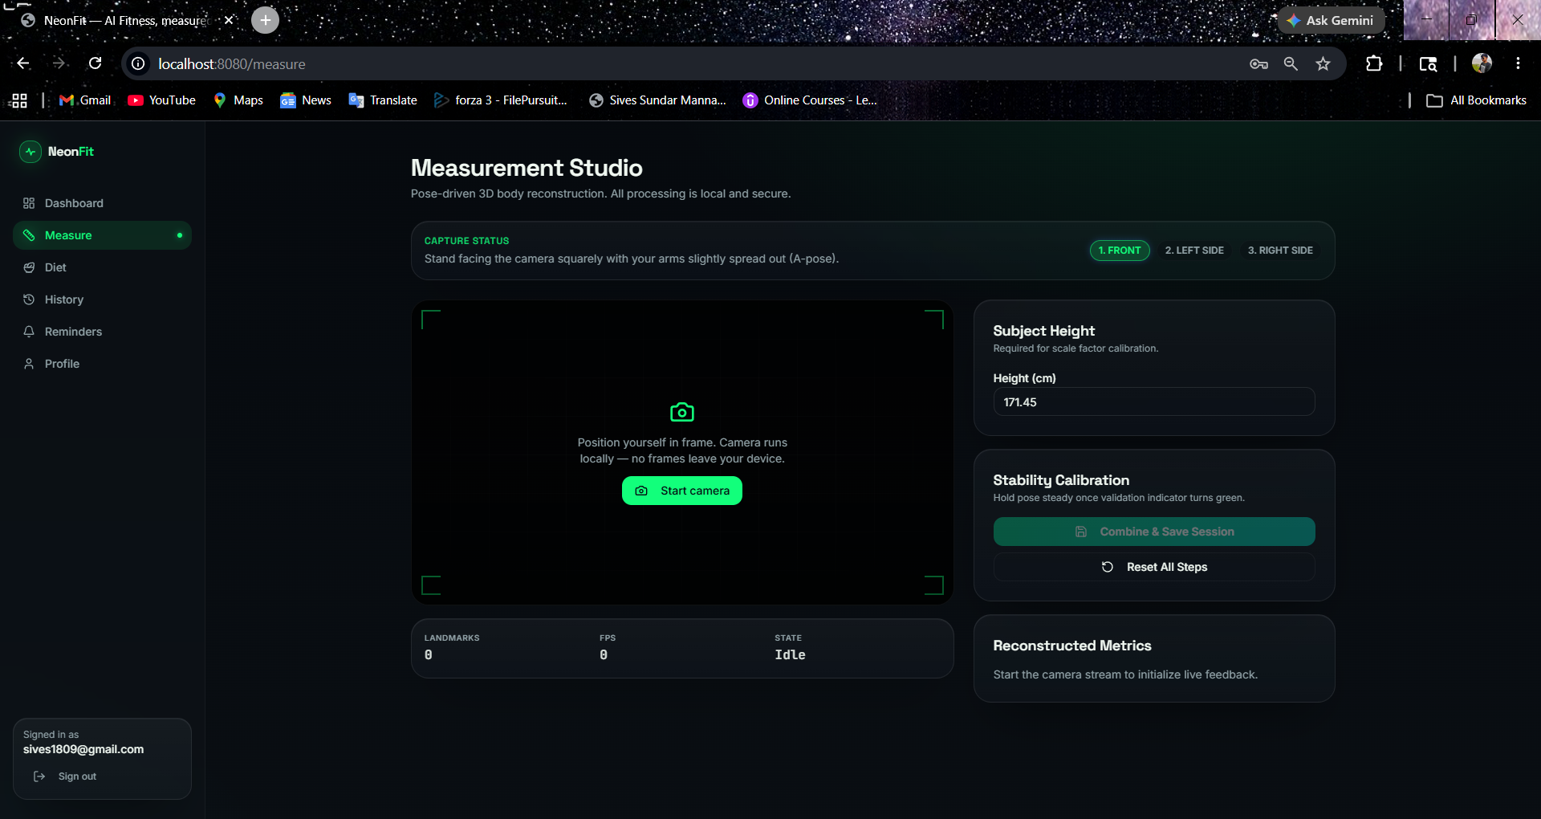


Current Working Results
Current Working Results
Metrics: chest girth, waist girth, hip girth, arm symmetry, thigh symmetry

Slide 15
Result Analysis
Observations:
  pose detection stable
  multi-view reconstruction feasible
  repeated measurements show reasonable consistency
  dashboard analytics functioning
  pseudo-3D girth estimation successful
Limitations:
  lighting sensitivity
  pose dependency
  calibration sensitivity
  measurement noise

Slide 16
Live Demonstration
Live demonstration or walkthrough of the working modules

Slide 17
Conclusion
NeoFit demonstrates:
  affordable AI-assisted body measurement
  multi-view pseudo-3D reconstruction
  automated fitness analytics
  longitudinal progress tracking
Contribution:
bridging computer vision + fitness analytics.

Slide 18
Future Scope
Future enhancement:
  improved calibration
  mobile deployment
  personalized AI coach
  advanced forecasting
  body composition estimation
  exercise recommendation engine
  larger validation dataset

Slide 19
Future Scope
SDG 3 — Good Health & Well-being
SDG 9 — Industry Innovation
SDG 4 — Quality Education

Slide 20
References
[1] H. Mohammedkhan, H. Fleuren, Ç. Güven, and E. Postma, “Inferring Body Measurements from 2D Images: A Comprehensive Review,” Journal of Imaging, vol. 11, no. 6, p. 205, 2025, doi: 10.3390/jimaging11060205.
[2] A. Nana, J. M. D. Staynor, S. Arlai, A. El-Sallam, N. Dhungel, and M. K. Smith, “Agreement of Anthropometric and Body Composition Measures Predicted from 2D Smartphone Images with Criterion Methods,” Obesity Research & Clinical Practice, vol. 16, no. 1, pp. 37–43, 2022, doi: 10.1016/j.orcp.2021.12.006.
[3] S. Choudhary, G. Iyer, B. Smith, et al., “Development and Validation of a Smartphone Application for Measuring Waist-to-Hip Circumference Ratio,” npj Digital Medicine, vol. 6, p. 168, 2023.
[4] T. J. Ferreira, I. C. Salvador, C. R. Pessanha, et al., “Advances in the Estimation of Body Fat Percentage Using an Artificial Intelligence 2D-Photo Method,” npj Digital Medicine, vol. 8, p. 43, 2025.
[5] R. B. Gadhiya and N. B. Kalani, “2D Image Based Digital Anthropometry Using Deep Learning Approach,” International Journal of Intelligent Systems and Applications in Engineering, 2024.
[6] C. Qiao, E. De Lucia Rolfe, E. Mak, et al., “Prediction of Body Composition Using 2D Image-Derived 3D Meshes,” Clinical Nutrition ESPEN, vol. 59, pp. 107–112, 2024.
[7] “Sex-Based Approach to Estimate Human Body Fat Percentage from 2D Images with Deep Learning and Machine Learning,” Measurement, vol. 219, p. 113213, 2023, doi: 10.1016/j.measurement.2023.113213.

Slide 21
Thank You

